Slide 1
Coastal Resilience Decade Collaborative Centre Launch Workshop
18 January 2023

Slide 2
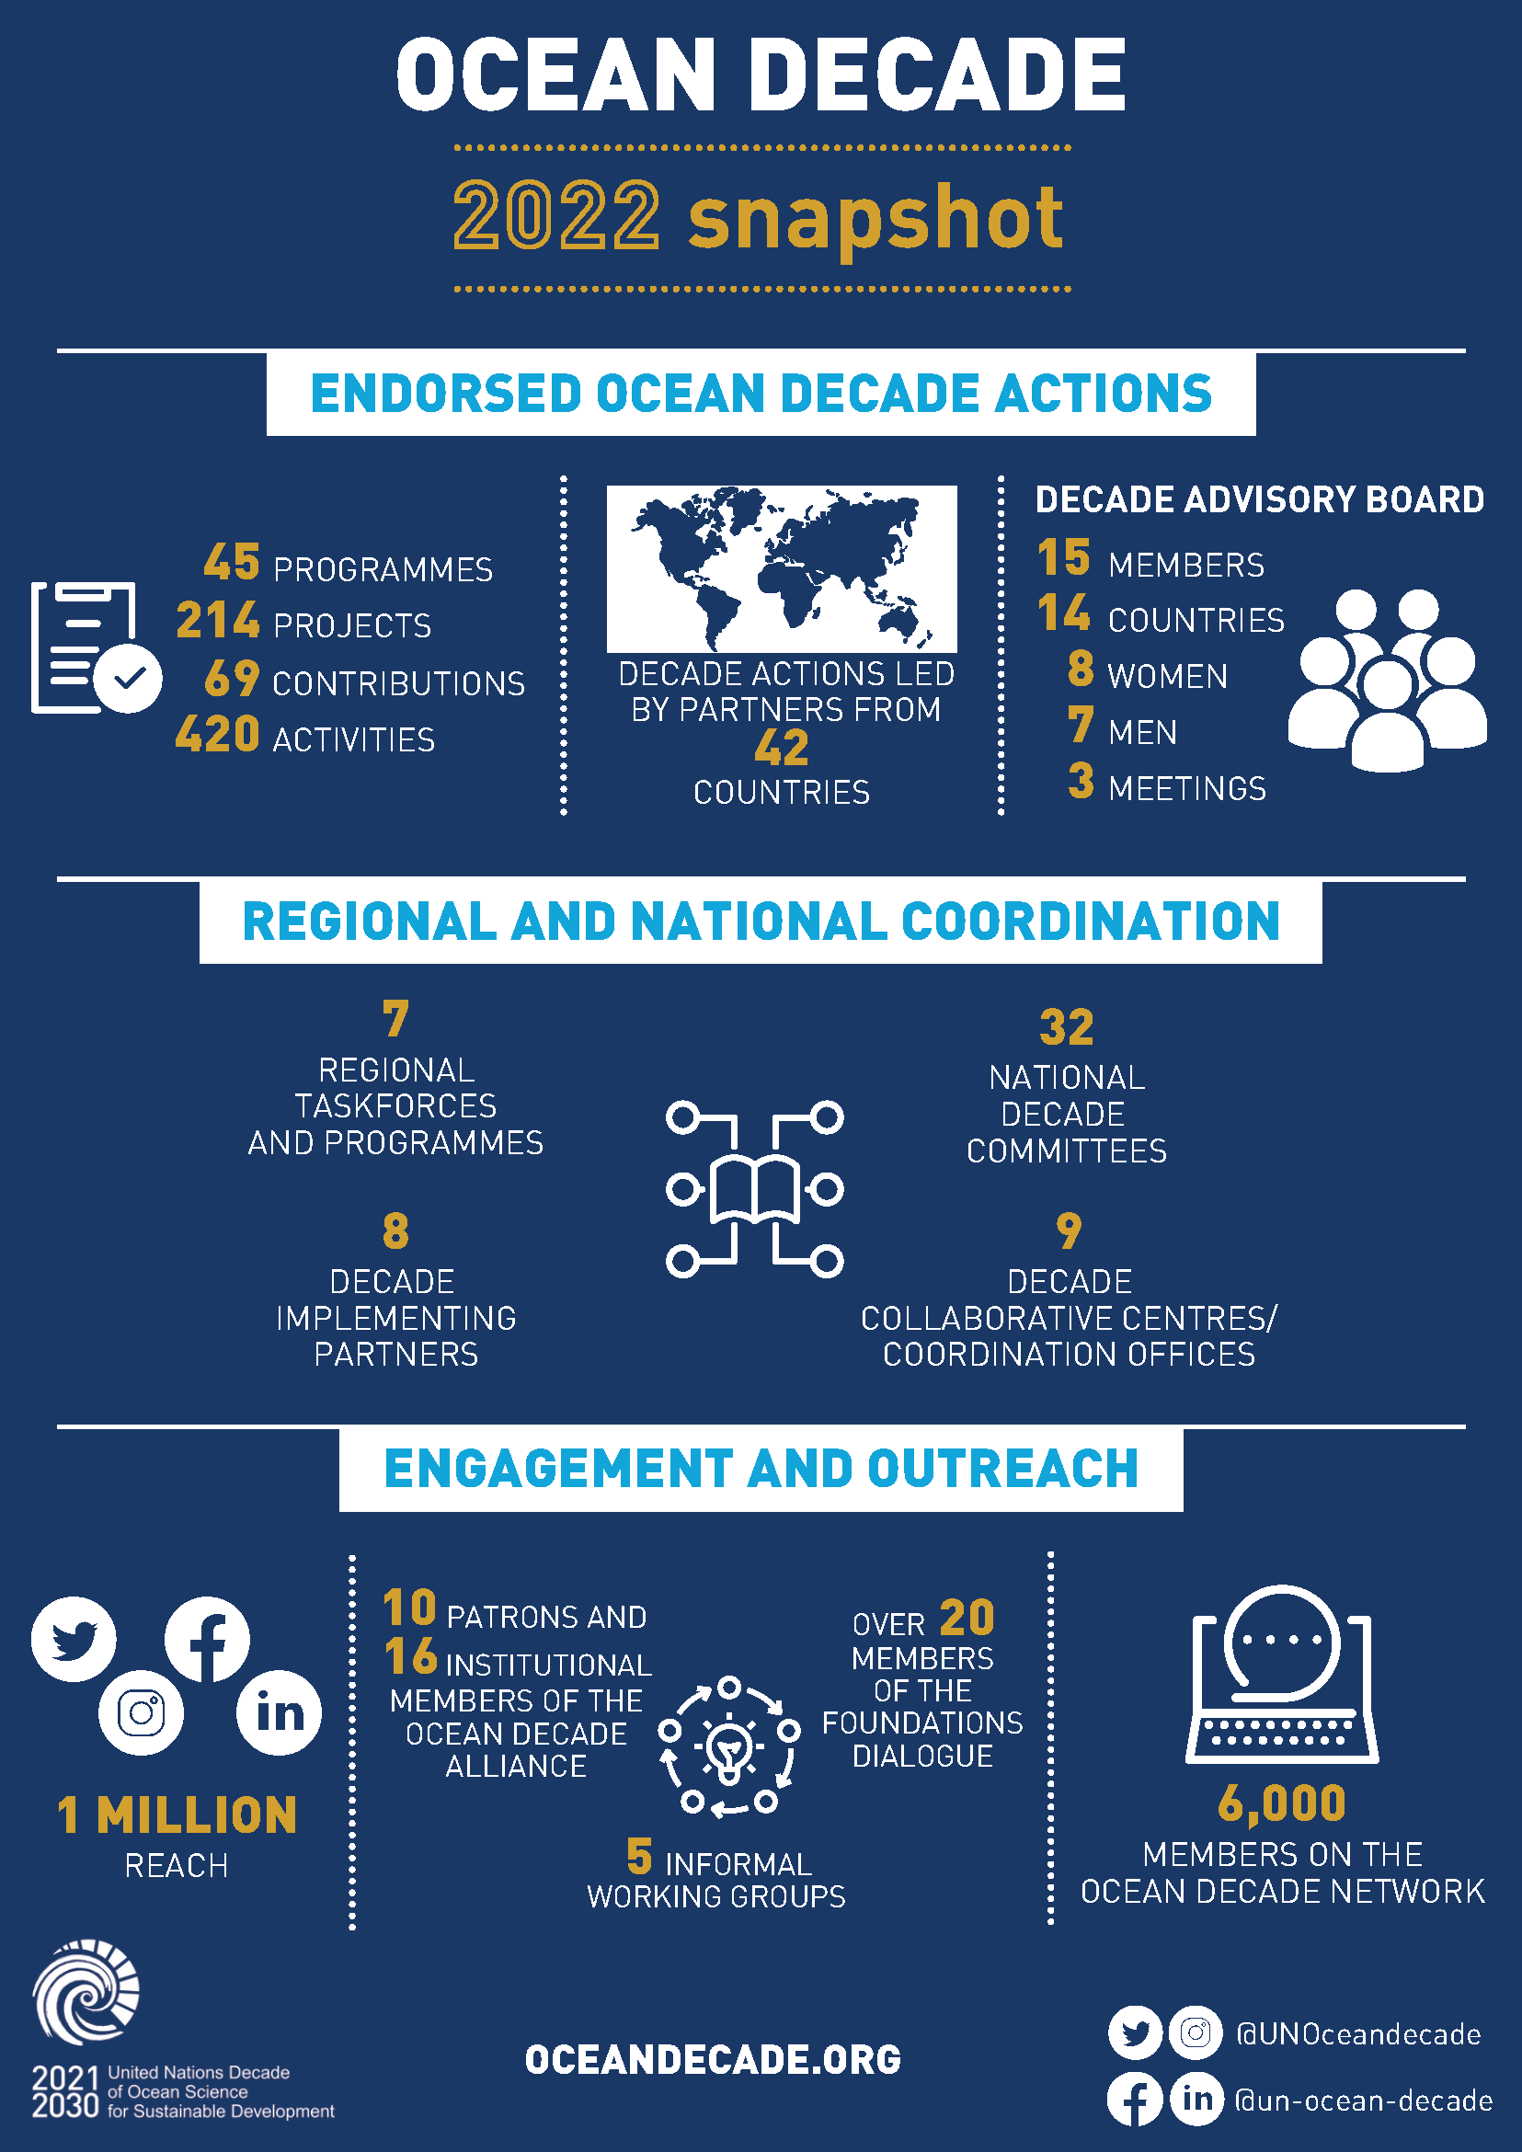

Slide 3
Decade Coordination Offices & Decade Collaborative Centres
Data Sharing (IOC – IODE)
Ocean Observations (IOC – GOOS)
Ocean Prediction (Mercator Ocean International)
Decade Implementing Partners
European Marine Board
National Decade Committees
32 NDCs established – additional efforts needed to encourage new NDCs in SIDS and LDCs
Western Pacific (IOC)
Ocean-Climate Nexus (FIO China)
Ocean-Climate Solutions (Ocean Visions)
North East Pacific (Tula Foundation)
JPI Oceans
Heirs to Our Ocean
EurOcean
National Institute of Oceanography and Fisheries (NIOF)
Peking University
The Administrative Centre for China’s Agenda 21
Indian Ocean (INCOIS)
Coastal Resilience (University of Bologna)
Decade Coordination Unit
DCOs and DCCs are essential parts of the overall governance and coordination structure of the Decade! DCCs have key role to play across numerous aspects of Decade implementation…

Slide 4
Creating Collective Impact via Communities of Practice
Communities of Practice => voluntary groups of endorsed Decade Actions
Communities of Practice aim to:
Help Decade Actions working on similar issues or in similar geographies find each and work together
Provide a space for Decade Actions to collaborate, co-design and create synergies to meet common goals in the implementation of their Actions.
Assist the DCU in scoping Calls for Decade Actions via gap analyses and in priority setting for Challenges
Decade Collaborative Centres / Decade Coordination Offices => “motors” of the Communities of Practice and sources of coordination support and resources
Working list of 20 COPs that will evolve and meet needs of community
Voluntary sign-up and leadership from Actions
Progressively rolling out virtual 'meet and greets' led by Decade Actions
Each COP will have space on the Ocean Decade Network
No prescriptive structure or mandate

Slide 5
Measuring Progress towards a Collective Strategic Ambition
First iteration of M&E Framework rolled out this week will measure basic information on knowledge generation and uptake
Next step in development is collectively identify the end-goal of each Ocean Decade Challenge, and measure progress to that goal
Roll-out will start in February 2023
Engagement by DCCs to help lead discussions!
1. Articulating priority user needs for sustainable development solutions
4. Setting Strategic ambition of Ocean Decade Challenge inc. indicators to measure achievement
3. Understanding residual gaps in datasets, knowledge, solutions & enabling environment
2. Mapping of existing datasets, knowledge, solutions, enabling environment and indicators

Slide 6
Supporting Demand Driven Capacity Development
Identify available CD initiatives
Match supply and demand & identify gaps
Identify CD needs of existing & future Decade Actions
Develop new initiatives to fill gaps
Develop partnerships & mobilise resources
Concept developed for Ocean Decade Capacity Development Facility
Initial funding being discussed => aim is for a multi-partner Facility for the life of the Decade
Initial support would include dedicated human resources in DCU for capacity development
DCCs to play a key role in socializing concept & supporting identification of needs

Slide 7
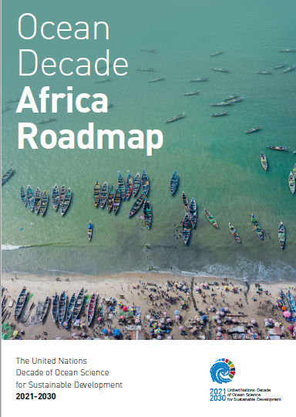
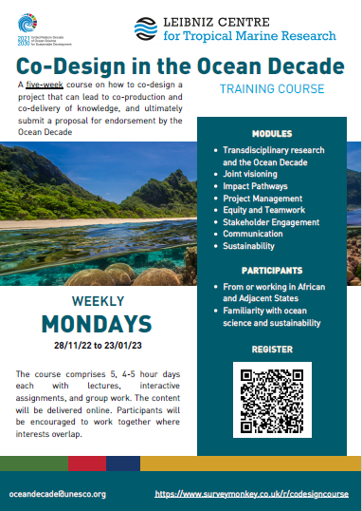
Priority Africa 2023 / 2024
Partners / donors meeting planned in mid March 2023, back-to-back with first in- person taskforce meeting
Discussing possible future support to expanded co-design training (pre-cursor to securing support for co-design processes)
Developing concept for a multi-partner Africa-focused sponsored Call for Decade Actions in 2023 or 2024 (likely to be 2 phases of co-design + implementation)
Notes:
Sustainable Ocean Management in Africa
This Decade Action will strengthen the data, knowledge-base and expertise required to develop and implement sustainable ocean plans in Africa. This will include innovative monitoring, coordinated and transboundary MSP plans, taking into account future socioeconomic development pathways. The Action will also focus on developing African capacities and entrepreneurship skills in sustainable ocean economy sectors, and tailored university programmes and blue skills actions, e.g. internships, institutional exchange programs, oriented to bridge employability, and meeting the needs of industry and society
2.Ocean and Human Health
This Action will identify priority knowledge gaps and policy needs in relation to the links between human health and the ocean. It will enhance the understanding of the links between ocean pollution (e.g. oil or chemical pollution) and ocean risks (e.g. Harmful Algal Blooms) on human health in specific African sub-regions. The results will be used to influence policy and management decisions including in the context of increasing demands for the provisioning of sustainable blue food and nutrition.
3.Unlocking the Blue Carbon potential of Africa
This Action will advance the mapping of blue carbon, identify mangrove and seabed restoration needs, and provide an assessment of the blue carbon potential at the regional level, bridging the Ocean Decade to the UN Decade for Ecosystem Restoration. It will work with the finance sector, industry and site managers to develop and test innovative financing mechanisms linked to blue carbon. It will engage government partners and local communities to develop participatory sub-national and national policy to optimize the role of blue carbon as a sustainable source of financing and as a generator of economic and social co-benefits. The programme will include capacity development and ocean literacy elements.
4.Fisheries and IUU in Africa
The aim is to identify the scientific gaps in monitoring IUU, upscale the gathering and analysis of data and information on IUU fishing in the EEZ, the high seas and ABNJ and impacts. This will enhance our understanding of the nature, extent of the ecological and socioeconomic impacts of IUU in the region. The Action will work with actors in the technology and innovation sector to identify adapted technological solutions to data collection and analysis. It will provide knowledge to policy makers, fisheries managers and authorities to influence decision making on strategies to address IUU in Africa.
5.Strengthening multi-hazards early warning systems and community resilience
This Action aims to close the gaps on observation data between sub-regions, develop tools for observing, forecasting, warning and anticipating climatic hazards e.g. operational platform and decision support system to address tsunamis generated by different sources, e.g., seismic activity, volcanoes, landslides etc. It will also promote research on extreme events (extreme cyclones and swells, etc.) through the development of coupled sea-atmosphere modelling tools. The Action will work with policy makers, local communities and disaster risk management authorities to influence policy and planning for community resilience. It will contain capacity development and ocean literacy components to increase awareness and understanding of risks and response measures.
6.Ocean Observations and forecasting systems for Africa
This Action would strengthen the Africa components of the ocean observations network as part of the overall development of the Global Ocean Observing System (GOOS). It would address specific needs to develop a network of ocean observation systems and regional forecasting models of ocean circulation, to provide baseline information on the oceanographic, biogeochemical and ecological state, changes and trends of the large marine ecosystems in Africa, and long-term coastal observations at key locations. It will also include harmonized approaches to data standards, metadata and processing of big data. It would work with industry and other stakeholders to optimize the collection of ocean observations by private or commercial vessels to feed into the observations system.
7.Digital twin for Africa - Establishing an African Ocean Knowledge Hub
This Action will establish and advance on the development of a regional ‘digital twin’ for Africa for centralizing marine data, modelling and simulations with artificial intelligence (AI) algorithms, specialized tools, and best practices. This will provide access to data and information required to develop human, environmental and economic scenarios, addressing issues such as energy, mining, fisheries, tourism and nature-based solutions, hence contributing to the knowledge-base required for the development of sustainable ocean plans. The Action would involve a strong element of co-design to ensure that the priority datasets, applications and services that were developed as part of the digital twin respond to the needs of users of ocean. The Action would include a specific focus on Indigenous and Local Knowledge. Capacity development would be integrated into all aspects of the Action both in the development of the digital twin and in the use of the applications and services. Engagement with actors from technology and innovation sectors would ensure that the technology used was adapted to the local context.
8.Strengthening capacities and skills of African Early Career Ocean Professionals (ECOPS)
The aim is to develop essential capacities and skills in Africa related to ocean science with a focus on scientific and technical skills of ECOPs. This Action would form part of the global ECOP programme and would build on the findings of the global survey of ECOP needs and priorities to provide targeted support via the African ECOP regional hub. It would include support for short and long term training; mentorship and professional development programmes; leadership training; support to engage international policy processes and discussions; a match-making service for access to research vessels and infrastructure; and other priority elements.
9. Regional ocean literacy programme
This cross-cutting programme will promote participatory research and co-design approaches; improve connections and collaboration with existing networks working on science communication and outreach. Policy and decision makers would be a key target group of this Action and much of the focus would be on initiatives to strengthen the science policy interface by increasing awareness and skills to access and interpret science for use in policy. Amongst other issues, the Action would appropriate tools for the dissemination of climate-information related to coastal and oceanic areas, and bolster understanding of the role of Indigenous and Local Knowledge as complementary, equally valued knowledge source.

Slide 8
2nd International Ocean Decade Conference
Barcelona, Spain – late April / early May 2024
Public announcement in coming weeks and planning to commence in early 2023
DCC engagement in planning and leading certain sessions!
Centre de Convencions Internacional de Barcelona - Barcelona International Convention Centre

